Slide 1
Sentiment Analysis
Data Set 3

Slide 2
Sentiment Analysis
Also known as Opinion Mining
Process of determining the emotional tone behind a series of words
Why Sentiment Analysis?
Social media monitoring- allows us to gain an overview of the wider public opinion behind certain topics
Product review analysis- helps you see what customers like and dislike about you and your brand
By reviewing your customer’s feedback on your business regularly you can be more proactive regarding the changing dynamics in the market place.
Insights and applications from SA have been useful in other areas
Politics/political science
Law/policy making
Sociology
Psychology

Slide 3
Introduction to our data set
Data set 3 contains Amazon reviews.
Size of the data set is around 400K documents
Each document is labelled as positive and negative.
Aim of our program is to take around 80% of the data as training set and use it to classify the rest of the 20% of data into two classes- positive and negative
Third algorithm chosen-
Support Vector Machine

Slide 4

Data pre processing
On each document-
We are removing the special characters like $, @ etc. as they do not help us to identify the classify the class of the opinion
Removing Diacritics
Example- RemoveDiacritics["naïve"]→ naive
Deleting Stop words
Example- DeleteStopwords["The blue ball had rolled under the table."]→ blue ball rolled table.
Converting all the rest of the words to lower case to bring the uniformity while we are trying to classifying the data
Feature Extraction-
We are applying Feature extraction on all the documents, which helps to reduce the document into a vector considering only the words which will help in identifying the sentiment of the document

Slide 5
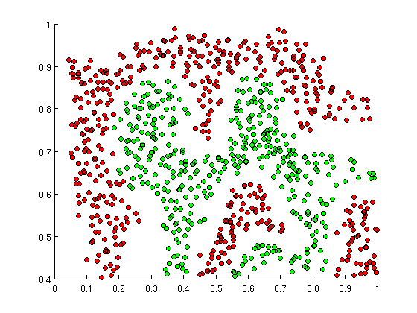
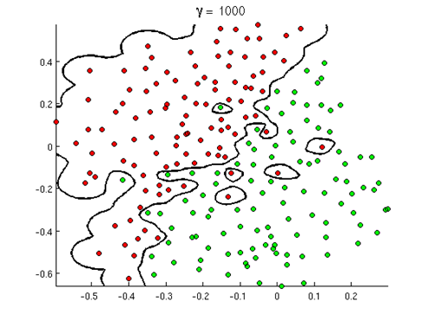
Advantages
Disadvantages
For models like shown in picture,
we cannot use any
linear regression function
which will help us to classify the
data into classes.
But we can achieve this using
SVM kernel
It tries to maximize the margin when compared to linear regression models, so
it is robust
It doesn’t overfit the data.
Training the data is very important.
If you do not train the data properly,
SVM might divide the set as shown
in the picture beside.
Need to have large data sets to improve the accuracy
Observations
Takes long time to train the data when compared to Random Forest, Neural Network and Markov
If proper training data set is not chosen, classification is hampered badly
Accuracy takes a toll for smaller training data. Accuracy is appreciable for large training data sets
Looking at the confusion matrix of the algorithm, we can draw inference that it usually classifies the data with good accuracy

Slide 6
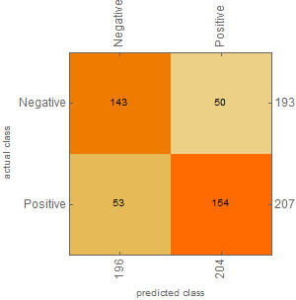
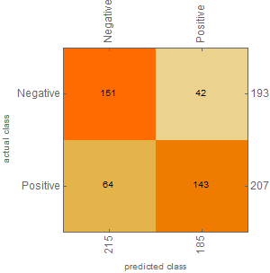


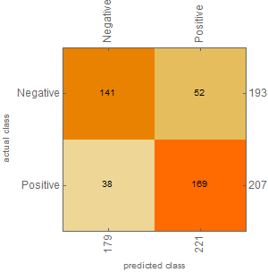
Confusion Matrix
Random Forest
Neural Network
Support Vector Machine
Markov
Logistic Regression

Slide 7
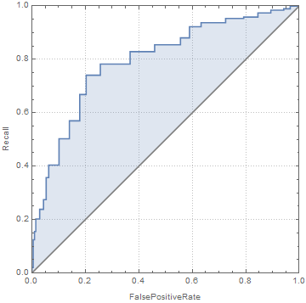
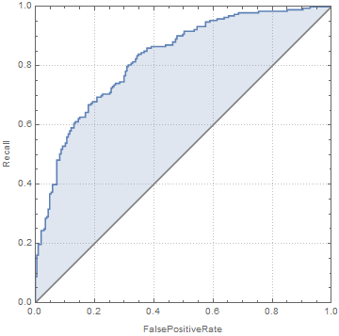
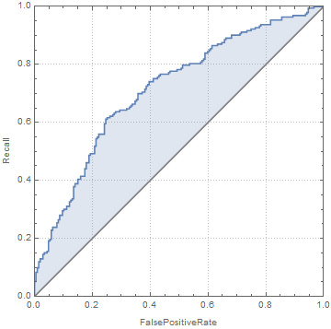
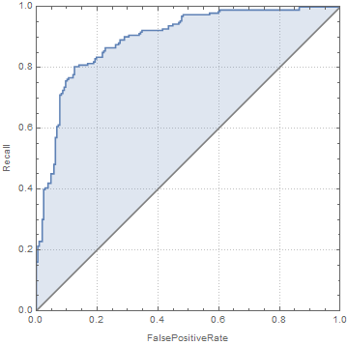
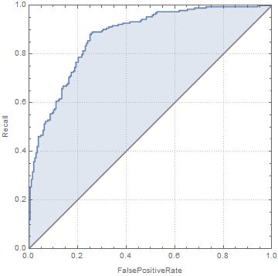
ROC
Random Forest
Neural Network
Support Vector Machine
Markov
Logistic Regression

Slide 9
Recall=TP/(TP+FN)
Precision=TP/(TP+FP)
Recall is the fraction of the relevant documents that are successfully retrieved
{completeness – what % of positive tuples did the classifier label as positive}
Precision is the fraction of retrieved documents that are relevant to the query
{exactness – what % of tuples that the classifier labeled as positive are actually positive}

Slide 10
Training data set will not affect your results in SVM- False
Kernels are available only in SVM- False
SVM can be applied for only non-lineary separable data- False
Random Forest-
Works both on small and large data sets. Quickly learns from training data. But gets confused when the data is large (which can be observed from confusion matrix)
Neural Networks

